Slide 1
Performance Testing Course : JMeter basics
Author: Hien HOANG

Slide 2
Agenda
About JMeter and installation.
Launching mode.
JMeter certificate
HTTPS Test Script Recorder
JMeter concepts.
Scenario properties.
Network simulation
Thinktime & pacing
Response code.
Some laws

Slide 3
JMeter overview
Open-source
Pure Java based application.
Lightweight.
Handy GUI
Run in GUI and Non-GUI mode.
Easy to enhance features by adding jar files.

Slide 4
Installation
Install JDK
Include JDK folder in the variable PATH
Verify if Java is configured correctly
Download JMeter from https://jmeter.apache.org/
Unzip downloaded file.
Run by start jmeter.bat file or jmeter.sh file depending on OS

Slide 5
Launching mode
GUI mode:
Preparing script, debugging script and smoke testing.
Non-GUI mode:
Used for performance testing since it consumes less memory.
Syntax : jmeter -n -t <path of .jmx> -l <path of .jtl or .csv>

Slide 6
Certificate
How to generate it? Fresh installation does not have this file. When you start recording, it will be generated.
Import to browser?
Chrome: Settings > Certificate > Manage Certificates > Imports… > Certificate Import Wizard > Browse to ApacheJMeterTemporaryRootCA.crt > Next > Finish.
Firefox : Settings > Tools/Options > Advanced / Certificates > View Certificates > Authorities > Import … > Browse to ApacheJMeterTemporaryRootCA.crt > Trust this CA to identify websites.

Slide 7
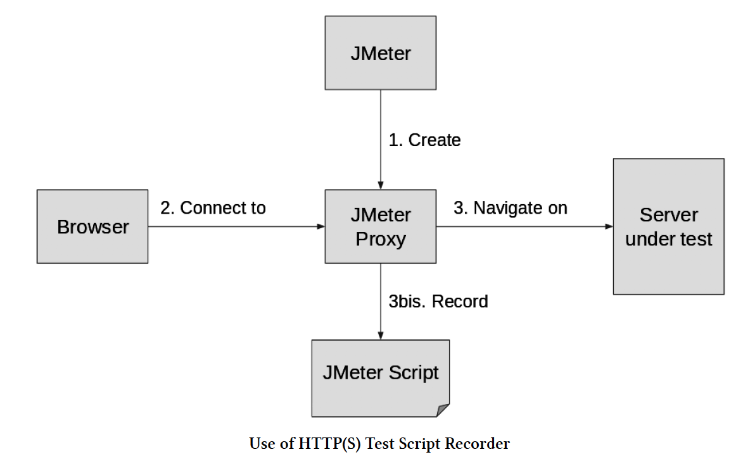
JMeter Https Test Script Recorder

Slide 8
HTTPS Test Script Recorder(continued)
Steps:
Follow this link for using Test Script Recorder : https://jmeter.apache.org/usermanual/jmeter_proxy_step_by_step.html

Slide 9
Important Jmeter concepts.
Scoping:
Elements in JMeter is organized in a Tree, where each node has its parents and children node.
Scope of element is composed of elements that are children of its own parents.
Execution order:
Rule 1: Pre-processor -> Timer -> Sampler -> Post processor -> Assertion -> Listener(position of different elements does not impact the execution order)
Rule 2: Outer element are executed before inner element of same type.
Timer scope:
Rule 1: Timers are executed before each sampler in their scope.
Rule 2: If there is more than 1 timer in scope, all timers will be processed before sampler.

Slide 10
Important Jmeter concepts.
3. Timer scope(continued):
We could control execution order of timer by:
“Add Think Times to the children” feature
Make timer to be children of sampler.(but it is less readable since timers are executed before sampler).

Slide 11
Important Jmeter concepts.
4. Assertion scope:
Rule 1: Assertions are executed after each sampler in their scope or to parent samplers.
Rule 2: Failed assertions cause failure of the entire Transaction Controller.
Rule 3: Assertions can validate main sample and/or sub-samples.
Rule 4: Be careful with low performing assertions : XPath Assertions, XML Assertions, XML Schema Assertion and HTML Assertion.
Tips: Add assertions as children of samplers.

Slide 12
Important Jmeter concepts.
5. Properties vs variable:
Similarity: Allow us to make data dynamic in JMeter.
Difference: Variables are tightly bound to thread, while properties are shared among all threads.
=> 2 rules:
Rule 1: Properties should be used for environment-related data.
Rule 2: Variables should be used for user-related data and correlation rules.

Slide 13
Important Jmeter concepts.
5. Properties vs variable(continued):
Where to define properties? We could create property and pass to JMeter by:
jmeter.properties file.
user.properties file.
Command line using -J option.
Command line using -G option.
Anny file referenced through command line option “-p” or “-propfile”
Anny file referenced through command line option “-q” or “-addprop”
Any file passed using command line option
By custom function ${__setProperty(propName, propValue)}
By JMeter-defined variable : props by using props.put(“propName”,”propValue”) or props.setProperty(“propName”,”PropValue”);

Slide 14
Important Jmeter concepts.
5. Properties vs variable(continued):
Where to define variable? We could create variable and pass to JMeter by:
User Defined Variables - a config element(more detail in config element slides)
User Parameters, a pre-processor.
JMeter functions that accept variable as last argument.
JMeter post-processor(extractor).
By JMeter-defined variable : vars by using vars.put(“varName”,”varValue”) or vars.putObject(“varName”, objectToBeUsed);

Slide 15
Important Jmeter concepts.
6. ${} vs ${__P}:
${}: Used for accessing variables by using ${varName}.
${__P}: Used for accessing properties by using ${__P(propA)}

Slide 16
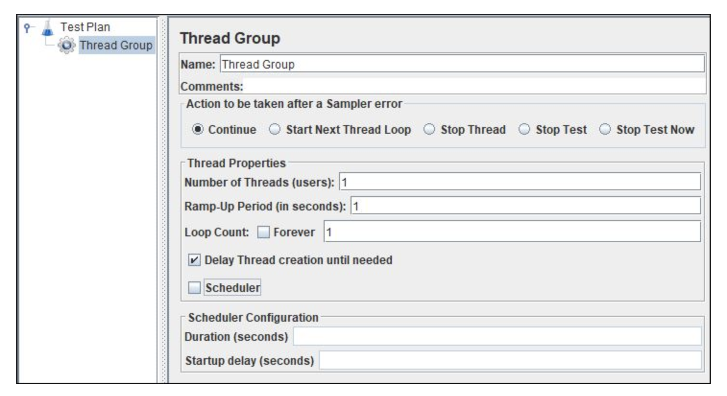
Goal-oriented Scenario Creation(continued)
Thread oriented goal:
Basic Thread Group: Helps to prepare basic scenario which includes ramp-up and steady state.
Limitations:
Only ramp-up and steady state can
be simulated.
Threads are ramp-up in linear manner
with same delay.
No option is available for gradual
ramp-down.

Slide 17
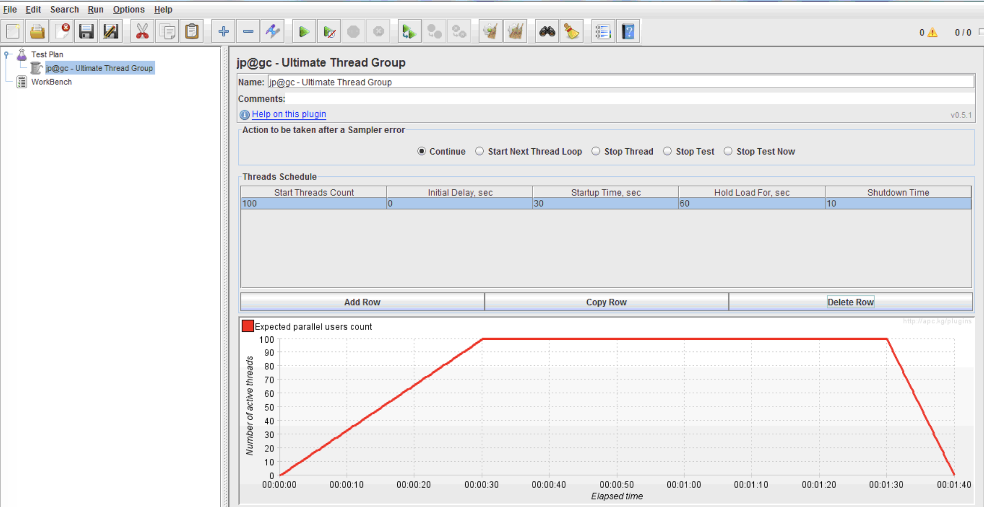
Goal-oriented Scenario Creation(continued)
Thread oriented goal(continued):
Ultimate Thread Group: Helps to apply conditional load on the server.
Limitations:
Need to calculate in order to
to create your desired load.
Thread may exit without completion of
iteration.

Slide 18
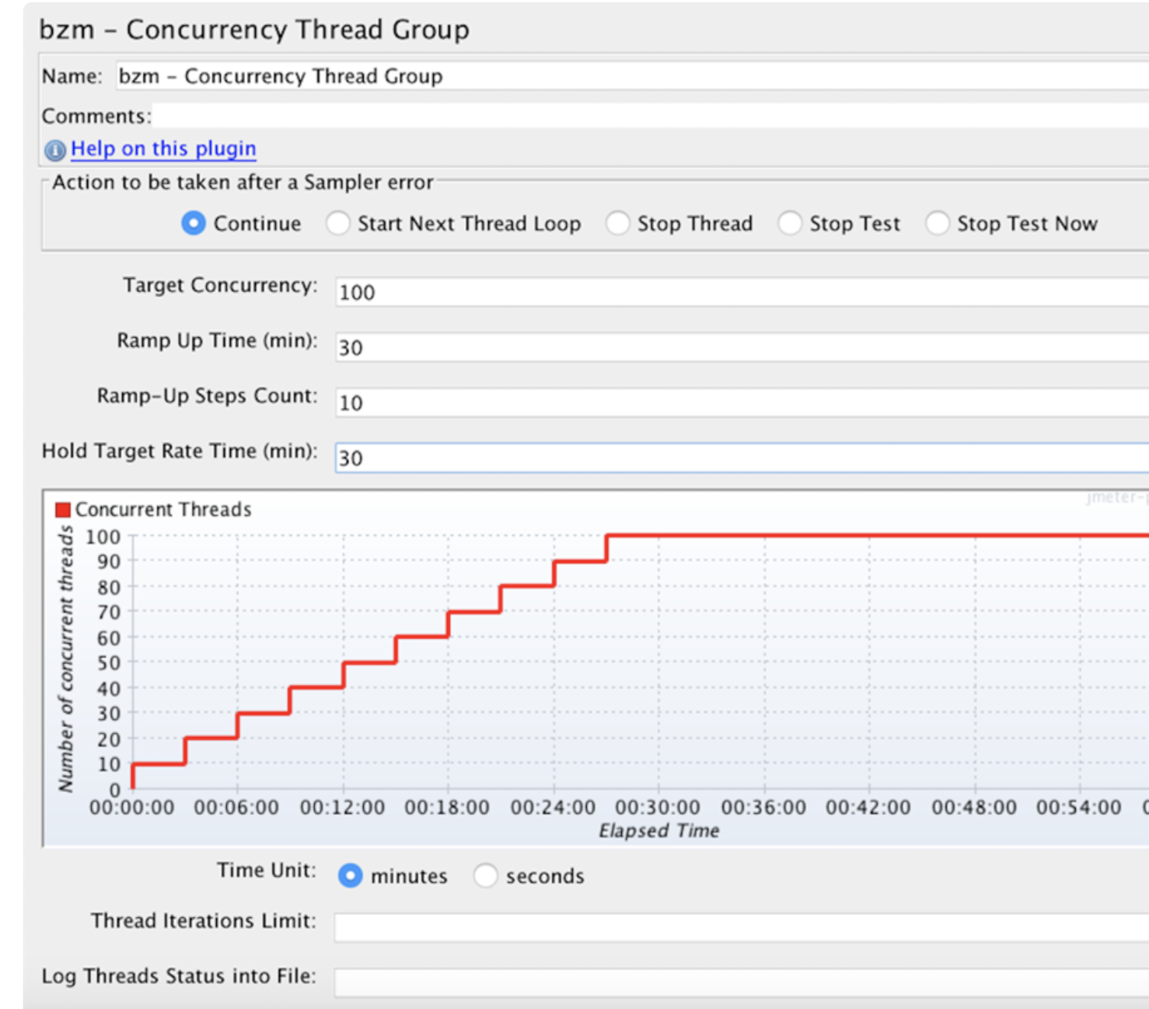
Goal-oriented Scenario Creation(continued)
Thread oriented goal(continued):
Concurrency Thread Group: Helps to control memory usage and stop active threads in graceful manner.
Limitations:
Only ramp-up and steady state can
be simulated
Used to create only basics scenarios.

Slide 19
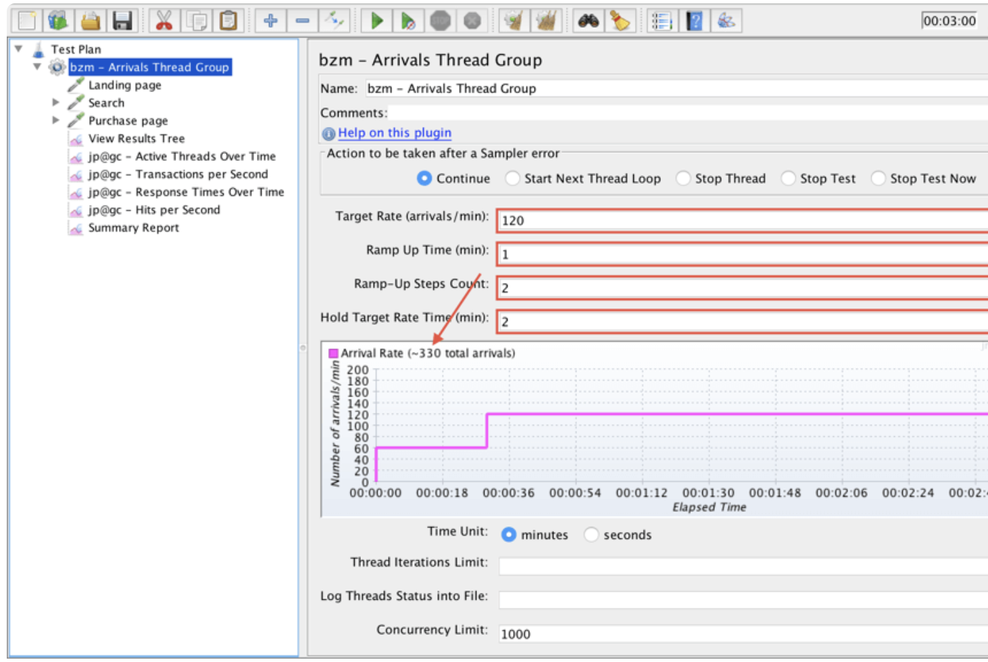
Goal-oriented Scenario Creation(continued)
2. Iteration oriented goal:
Achieve defined number of iterations.(i.e X orders or ticket should be booking in Y unit of time)
Arrival Thread Group:
Limitations:
Only ramp-up and steady state can
be simulated
Thread are ramp-up only on the basis
of arrival rate.

Slide 20
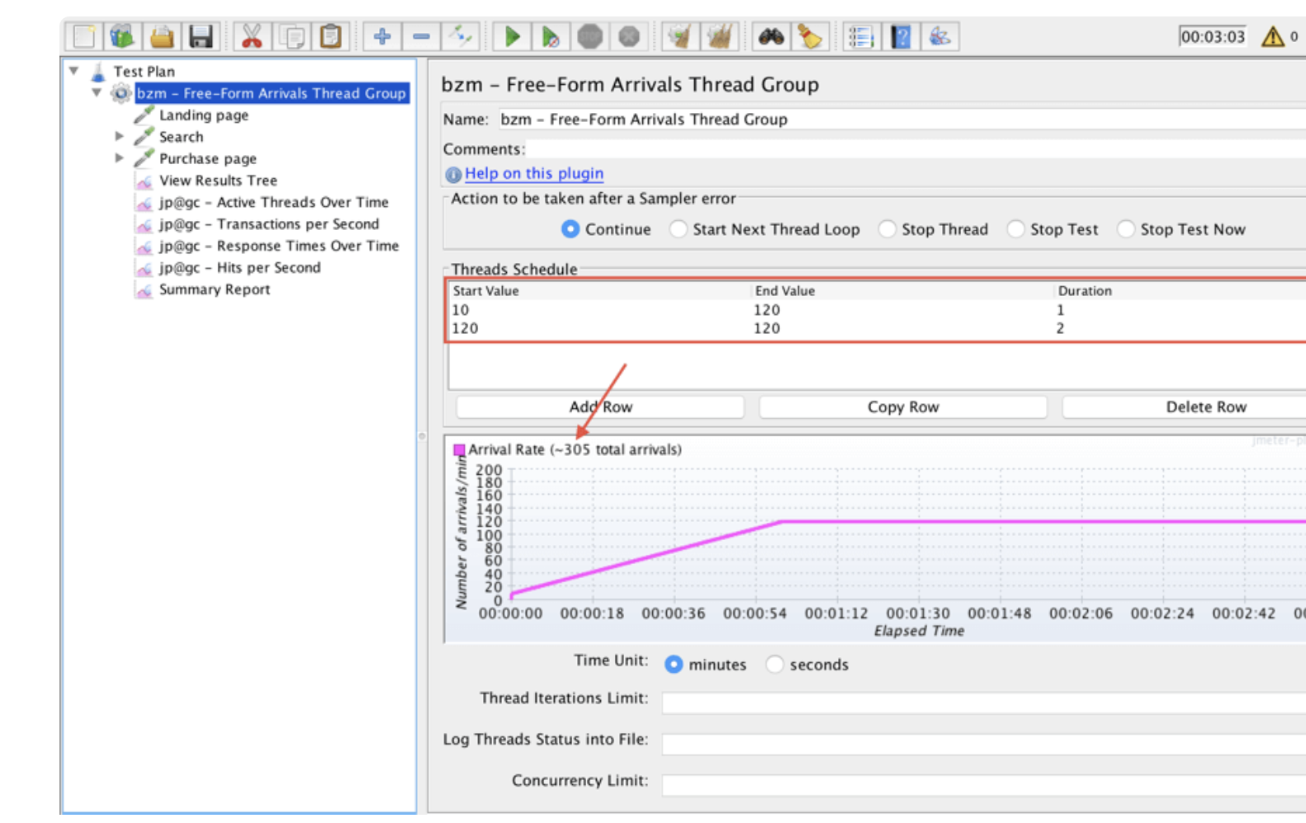
Goal-oriented Scenario Creation(continued)
2. Iteration oriented goal:(continued)
Free-forms Arrivals Thread Group: helps to apply conditional load on server.
Limitations:
Can not ensure that the script will run
until the end.

Slide 21
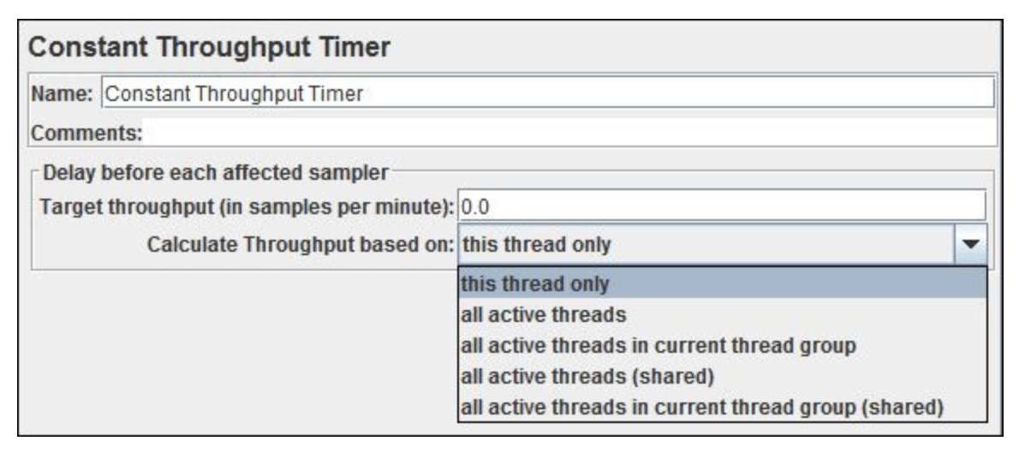
Goal-oriented Scenario Creation(continued)
3. Request oriented goal:
Achieve defined number of requests in an hour.
Constant Throughput Timer:
Maintain constant throughput during the test
and achieve the target.
Limitations:
May be impacted by other timer.
No. of thread should be calculated.
Threads do not stop in graceful manner.

Slide 22
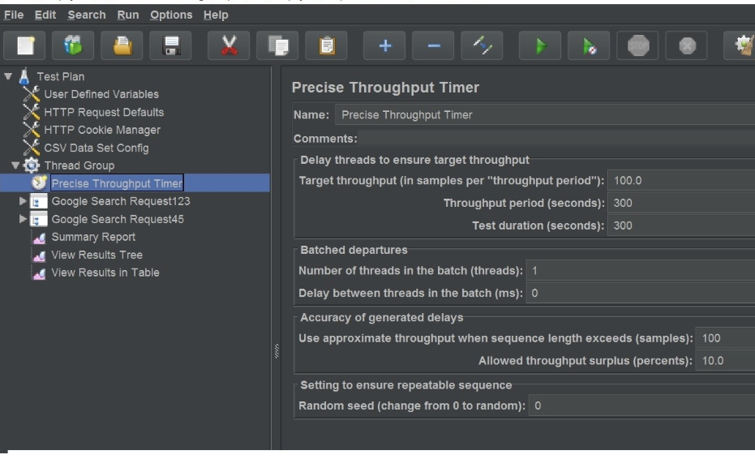
Goal-oriented Scenario Creation(continued)
3. Request oriented goal:(continued.)
Precise Throughput Timer:
Maintain constant throughput during the test
and achieve the target.
Limitations:
Calculation is needed.

Slide 23
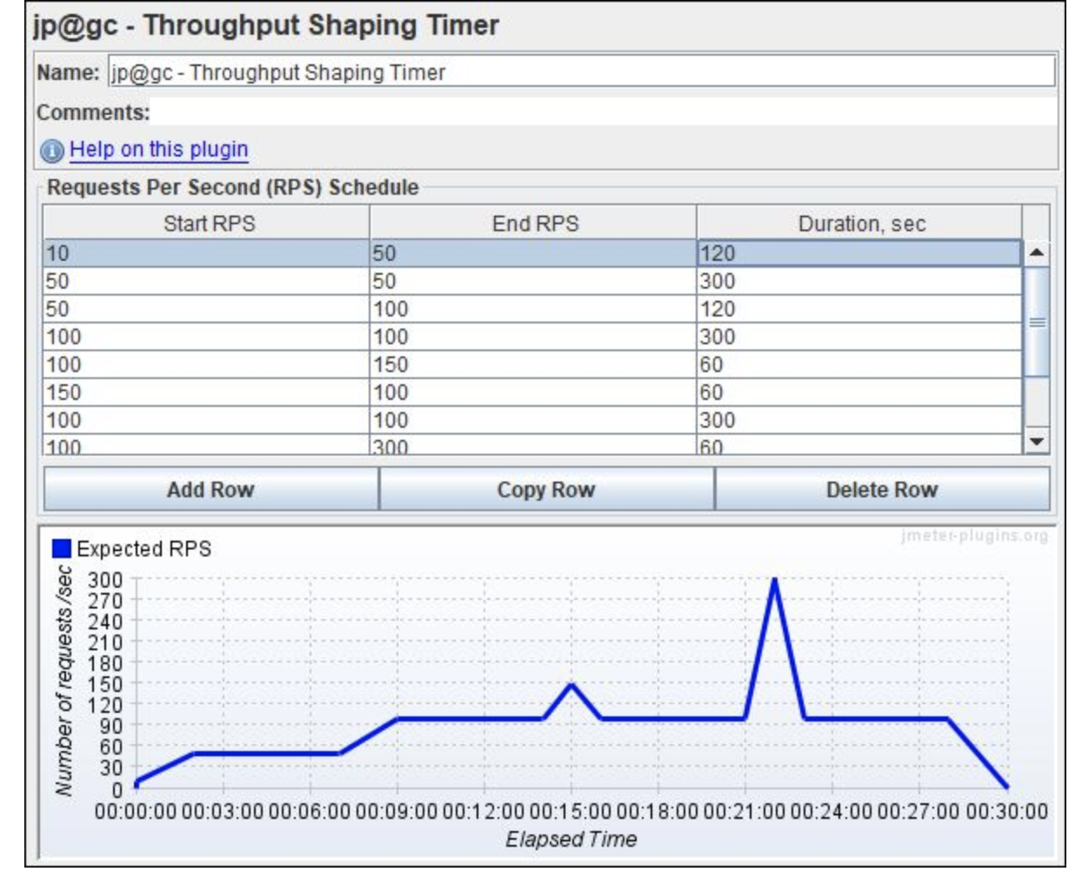
Goal-oriented Scenario Creation(continued)
3. Request oriented goal:(continued)
Throughput Shaping Timer:
Most flexible timer.
Limitations:
RPS should be calculated and configured.

Slide 24
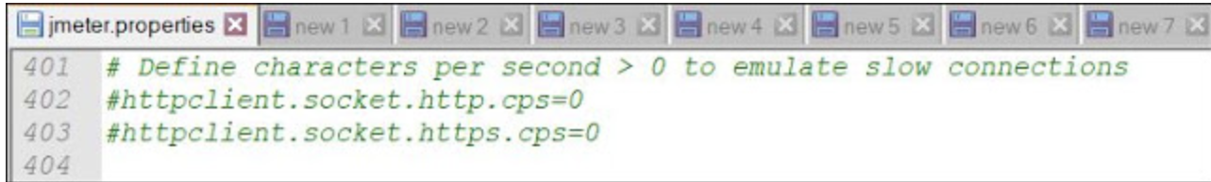
Network speed simulation
Edit in jmeter.properties file httpclient.socket.http.cps and httpclient.socket.https.cps.
Formula : CPS = RB * 128 where rb = required bandwidth, cps = characters per second.
We can also set this value in command line: jmeter -Jhttpclient.socket.http.cps=xxxxx -n -t <path of .jmx> -l <path of .jtl or .csv>

Slide 25
Thinktime & Pacing
Why thinktime?
Create real-world scenario by allows VU to pause in the business flow while moving from one business transaction to another.
Prevent out of memory error.
Why pacing?
Regulate the rate of requests hitting to the server.
Correct paving give exact load handling capacity of server.

Slide 26
Response code
HTTP 1xx : Informational (100: Continue, 101: Switch Protocols)
HTTP 2xx : Successful(200:OK, 201: Created, 202: Accepted,etc,..)
HTTP 3xx: Redirection(300: Multiple Choices, 301: Moved Permanently, 303: See Other,etc…)
HTTP 4xx: Client error(400: Bad request, 401: Unauthorized, 403: Forbidden, 404: Not Found,etc…)
HTTP 5xx: Server error(500: Internal Server Error, 502: Bad Gateway, 501: Not Implemented,etc..)

Slide 27
Concurrent user vs Simultaneous user
Concurrent user: Users which are running under test plan, irrespective of the activities that they are doing.
Simultaneous user: Users that are instructed to perform same transaction together at a point in time.

Slide 28
How to make test realistic?
Real user behavior: Random navigation, random input, random selections,random thinktime,browser simulation
Real user load patterns: Transaction rate, Geographical Location, Bandwidth, Transaction Type

Slide 29
Little’s Law
Formula: N = Throughput * ( Response Time + ThinkTime)
Why it is so much important? Verify if performance test results are accurate.

Slide 30
Other interesting laws
Utilization law: Utilization = Throughput * Service Demand Time
where service demand is amount of time required to execute/process a request.
Bounding Analysis Law : Throughput(max) = 1 / Service Demand Time.
Forced Flow Law : Request arrival rate = Throughput when Throughput < Throughput(max)

